Slide 1
Middleware
https://www.youtube.com/watch?v=vw3yv2AVaTE

Slide 2
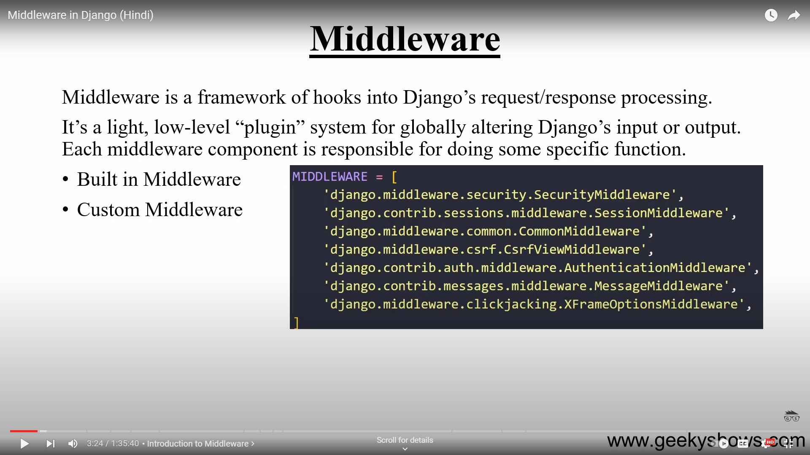
MIDDLEWARE

Slide 3
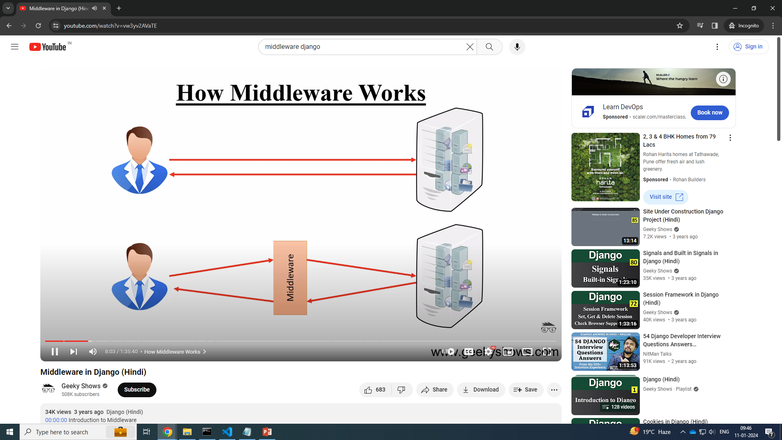

Slide 4
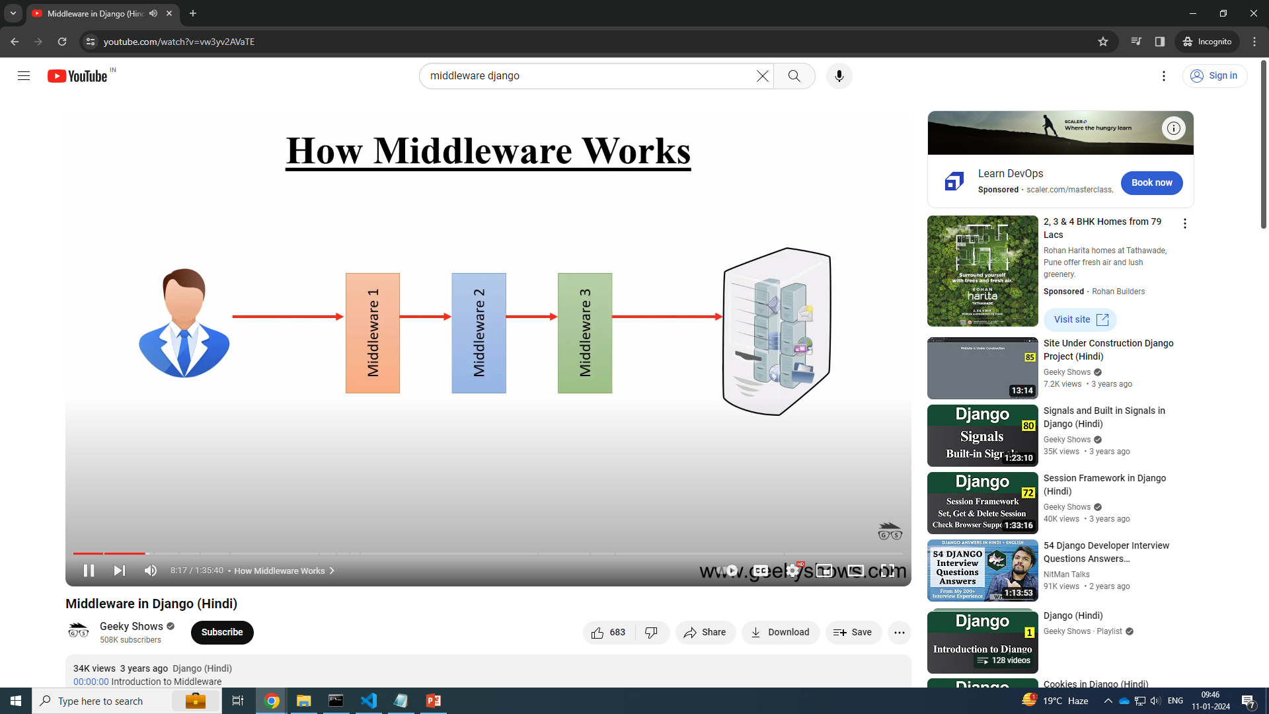
how middleware works

Slide 5
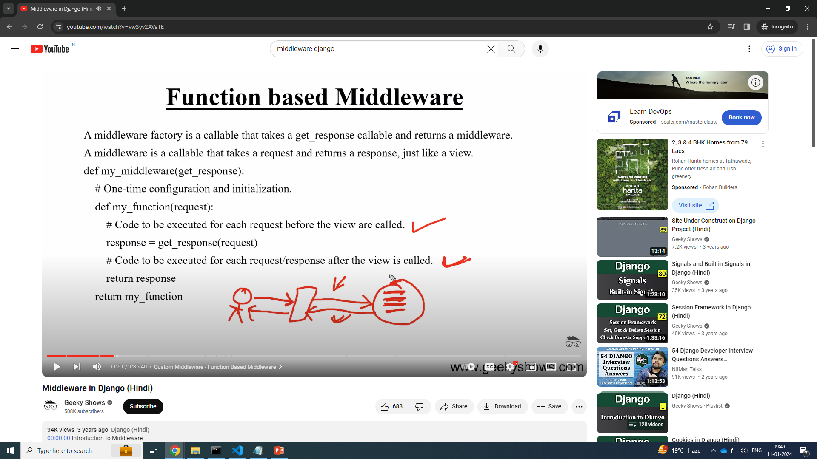
function based middleware

Slide 6
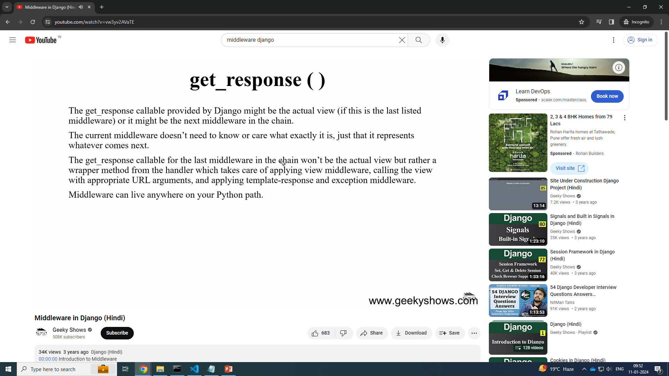
get_response()

Slide 7
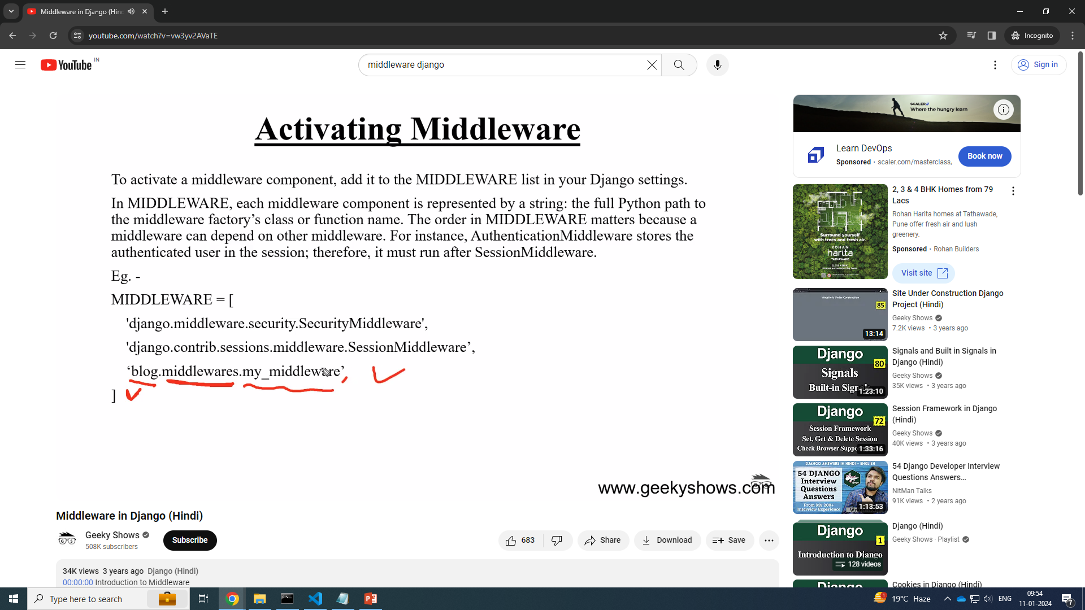
Maintain order

Slide 8
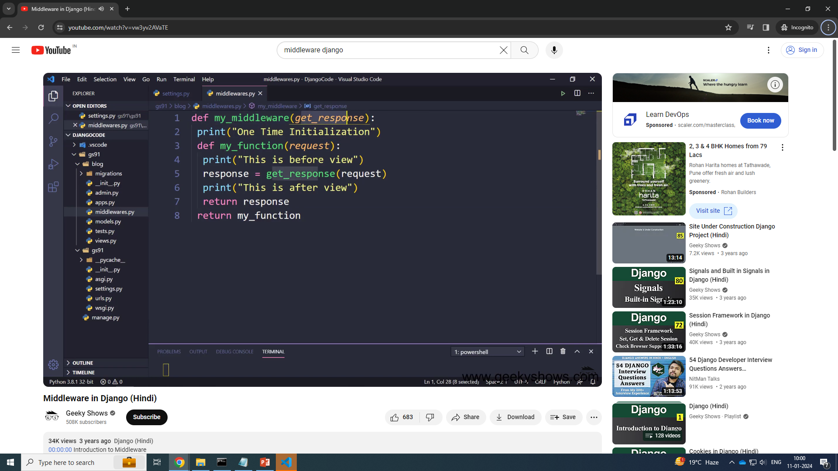

Slide 9
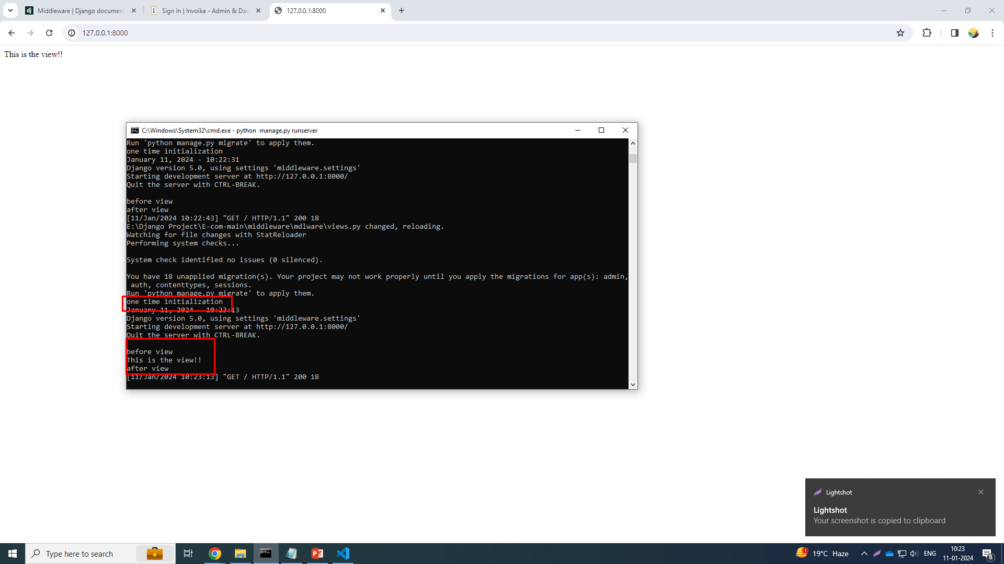

Slide 10
mymiddleware.py
# middleware creations
# register/active middleware in settings.py file like appname.middleware_file.function_name
def My_middleware(get_response):
print("one time initialization")
def my_func(request):
print('before view')
response = get_response(request)
print('after view')
return response
return my_func

Slide 11
Views.py
from django.shortcuts import render, HttpResponse
def Home(request):
print('This is the view!!')
return HttpResponse('This is the view!!')

Slide 12
Urls.py
from django.contrib import admin
from django.urls import path
from mdlware import views
urlpatterns = [
path('admin/', admin.site.urls),
path('', views.Home),
]

Slide 13
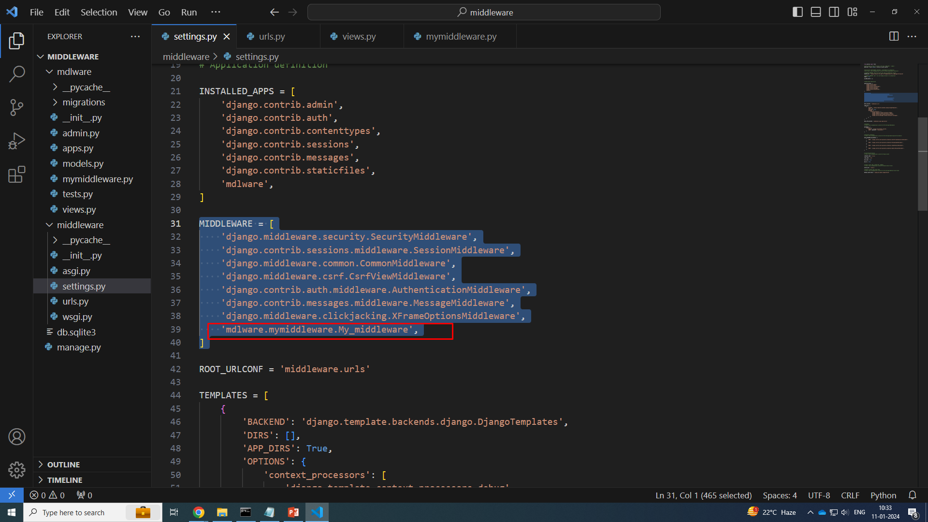
Settings.py

Slide 14
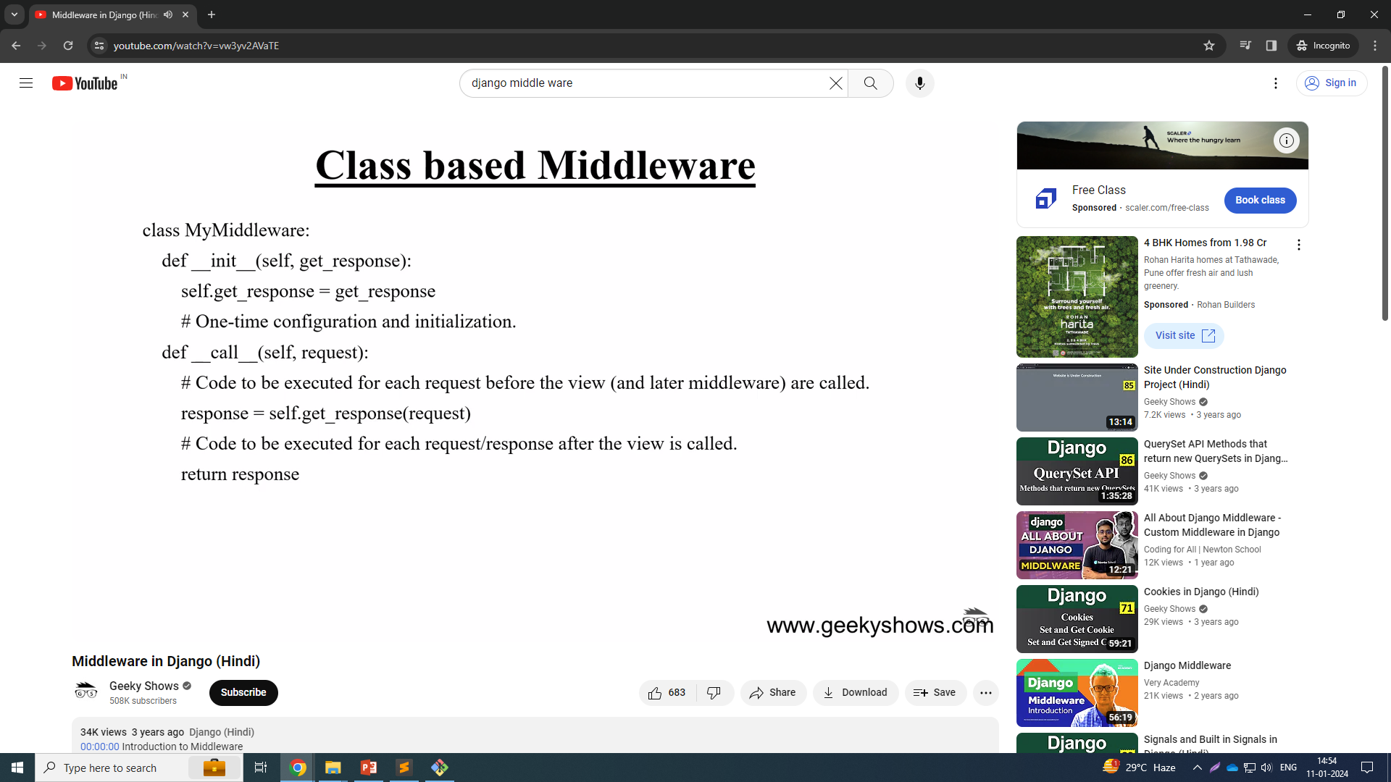
Class based middleware

Slide 15
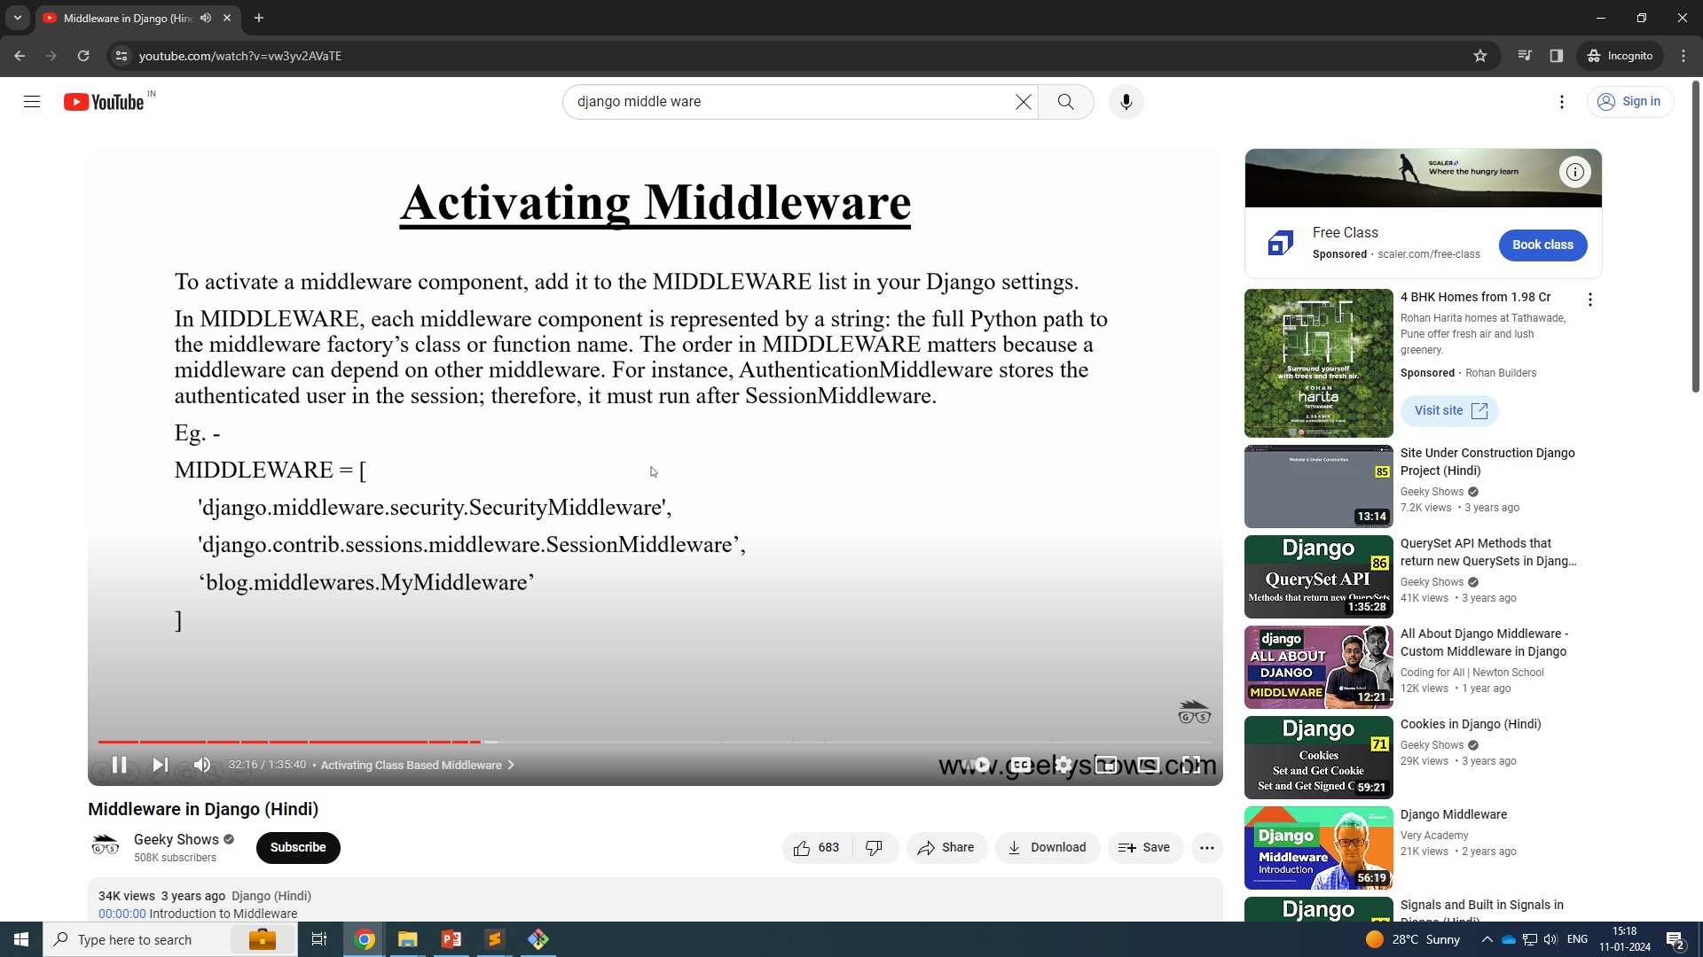

Slide 16
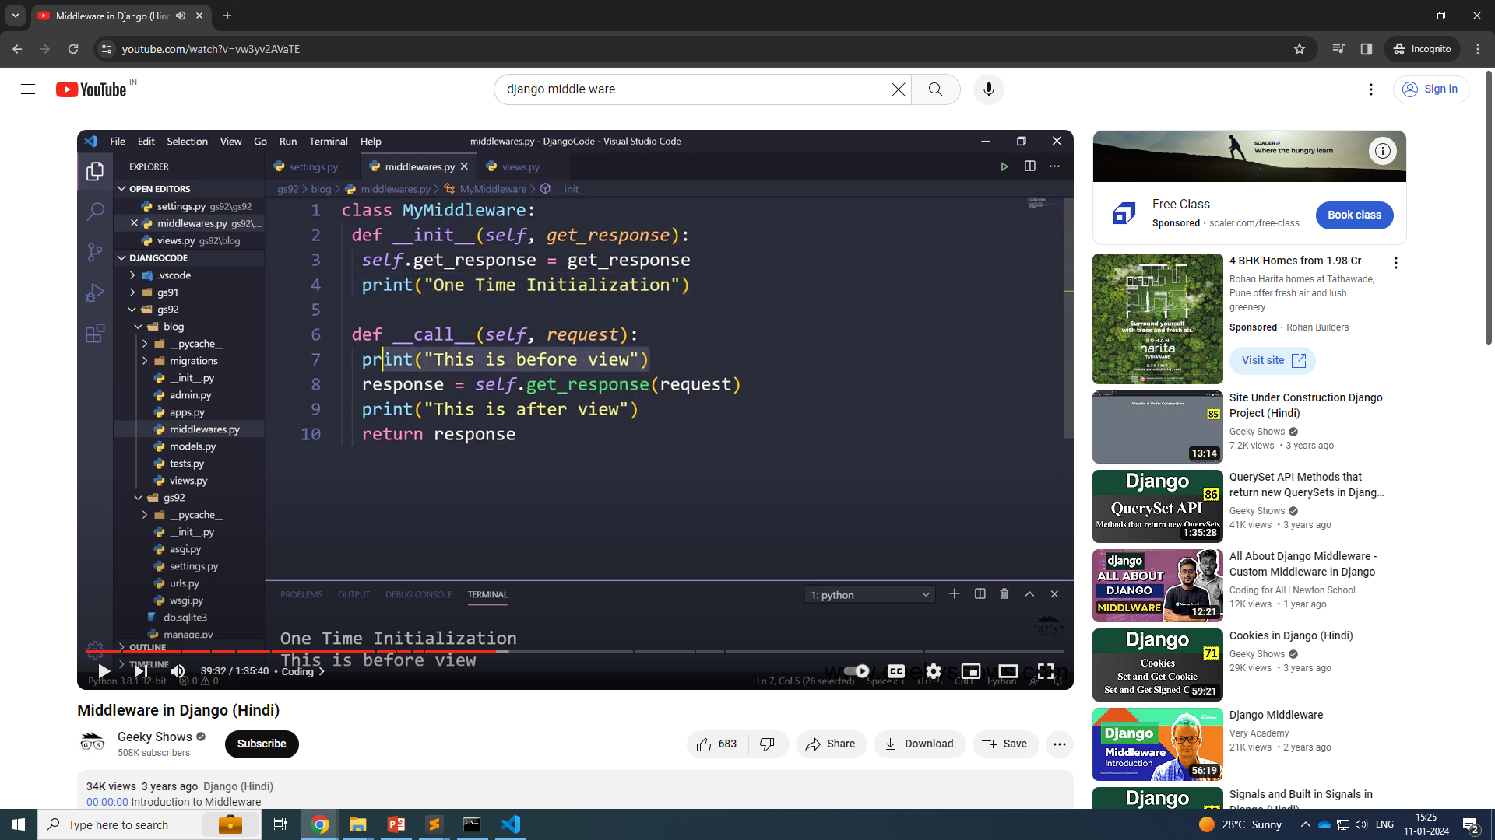

Slide 17
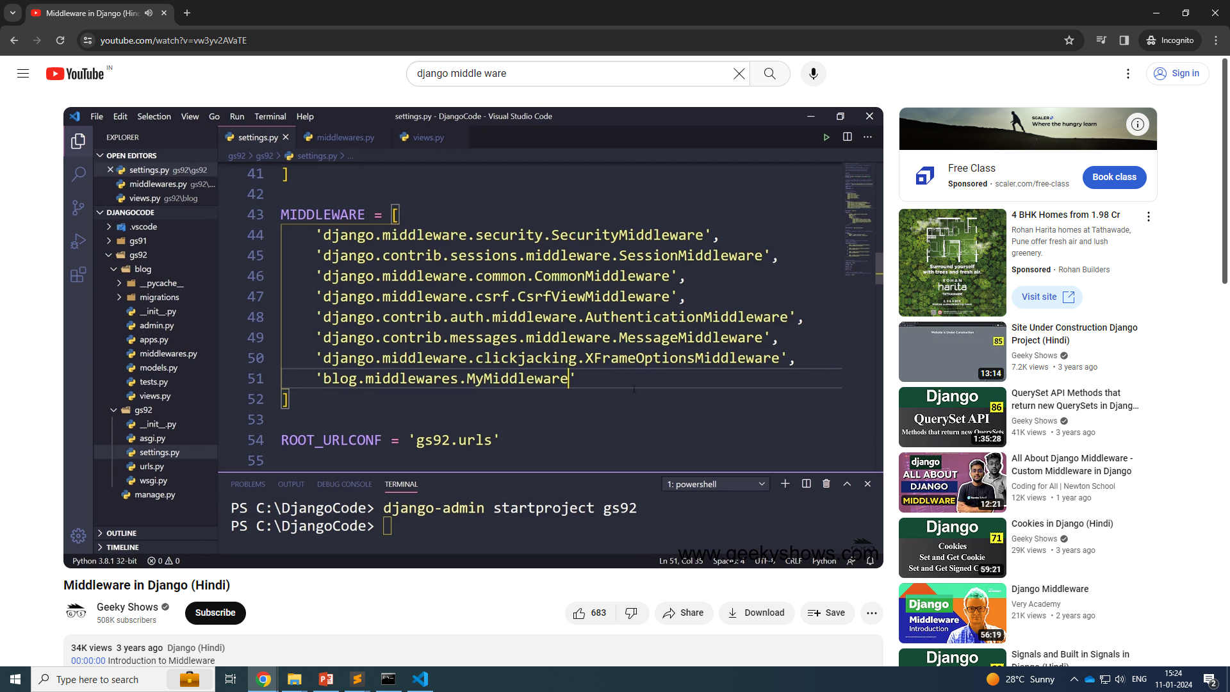

Slide 18
Setting.spy
MIDDLEWARE = [
'django.middleware.security.SecurityMiddleware',
'django.contrib.sessions.middleware.SessionMiddleware',
'django.middleware.common.CommonMiddleware',
'django.middleware.csrf.CsrfViewMiddleware',
'django.contrib.auth.middleware.AuthenticationMiddleware',
'django.contrib.messages.middleware.MessageMiddleware',
'django.middleware.clickjacking.XFrameOptionsMiddleware',
# 'mdlware.mymiddleware.My_middleware',
'mdlware.classbase_middleware.MyMiddleWare'
]

Slide 19
class MyMiddleWare():
def __init__(self, get_response):
self.get_response = get_response
print('one time run')
def __call__(self,request):
print("before view")
response = self.get_response(request)
print("after view")
return response

Slide 20
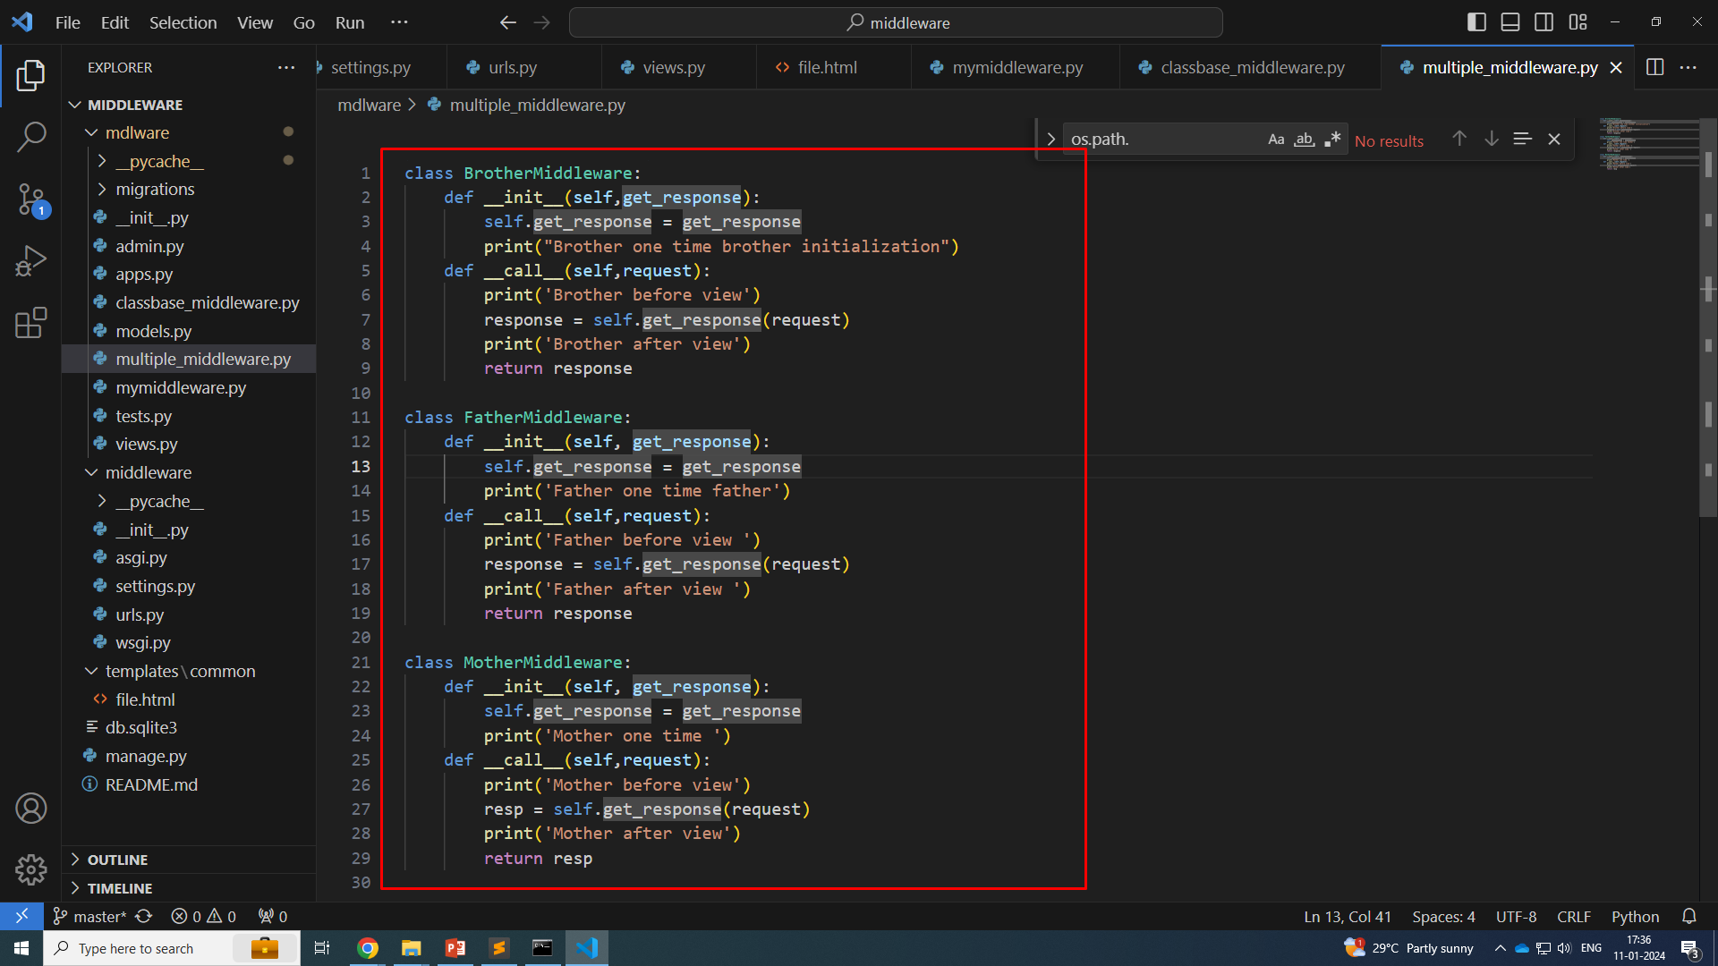

Slide 21
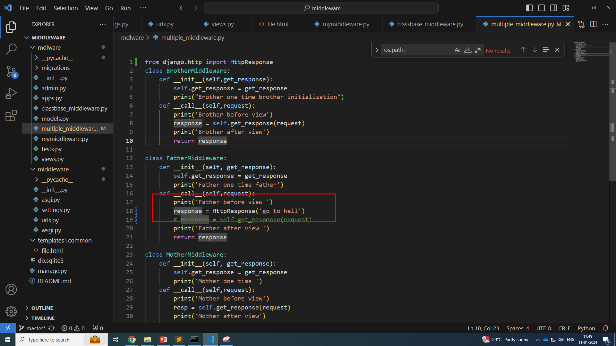
Response froom second middle ware

Slide 22
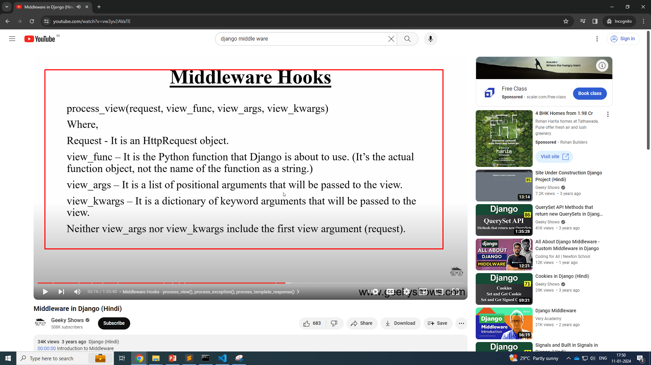
Middleware Hook

Slide 23
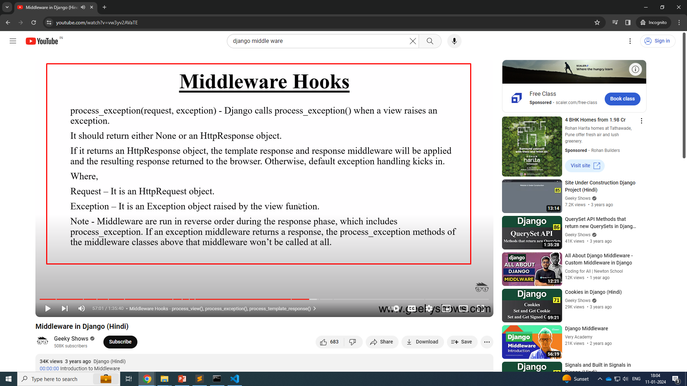

Slide 24
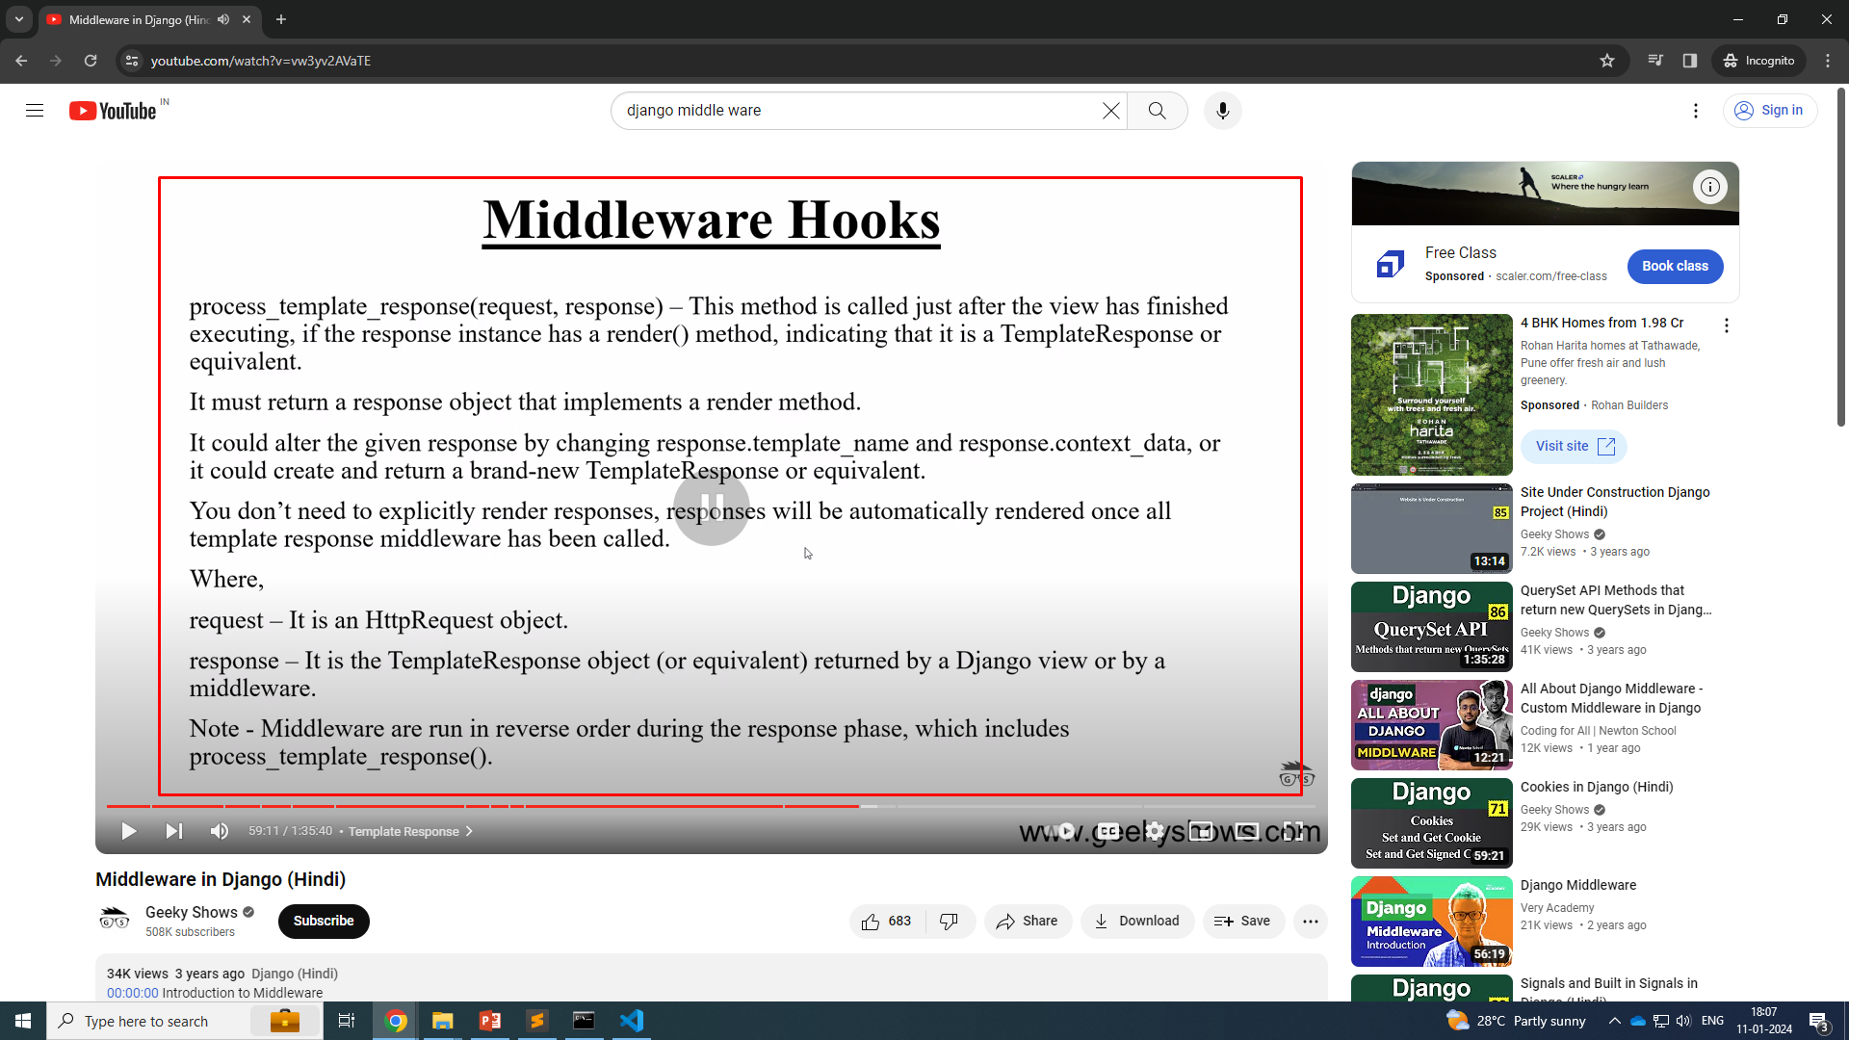

Slide 25
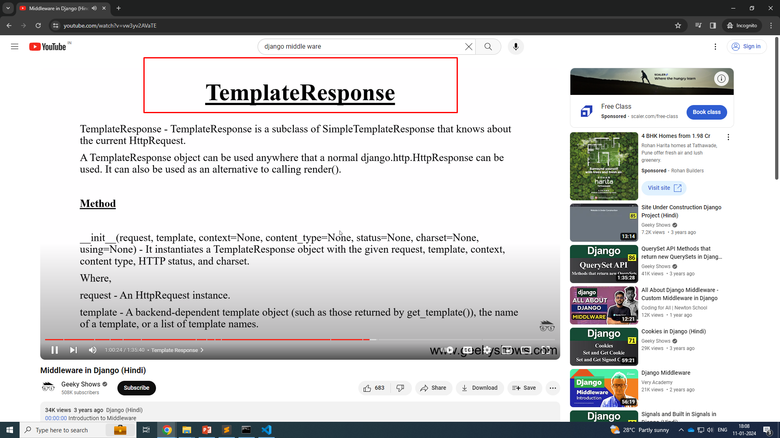

Slide 26
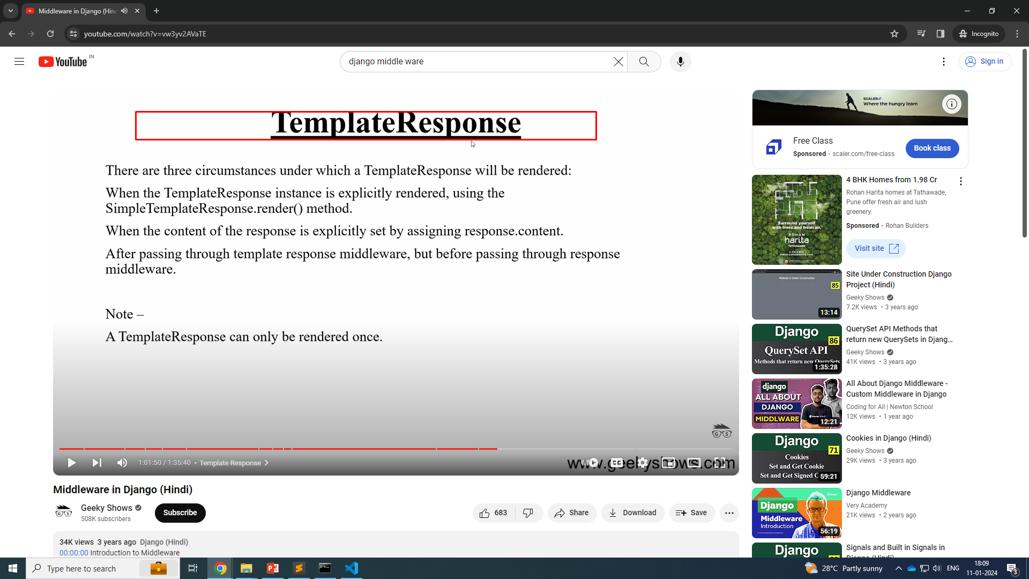

Slide 27
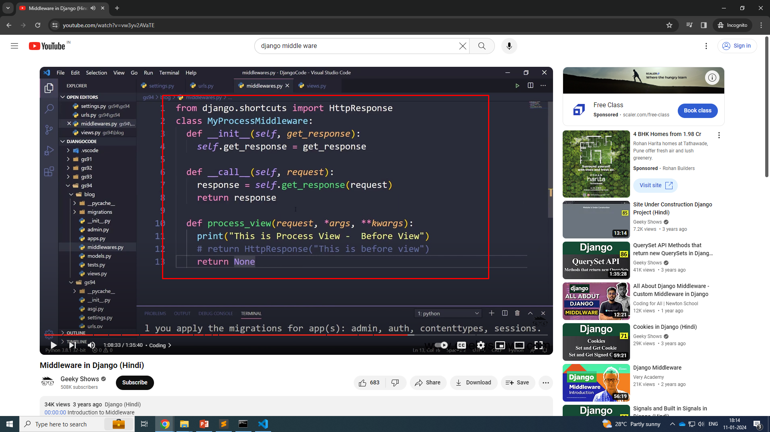
process_view

Slide 28
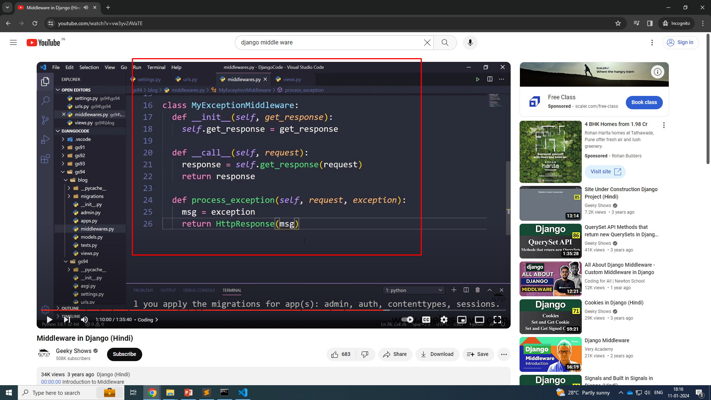
process_exception

Slide 29
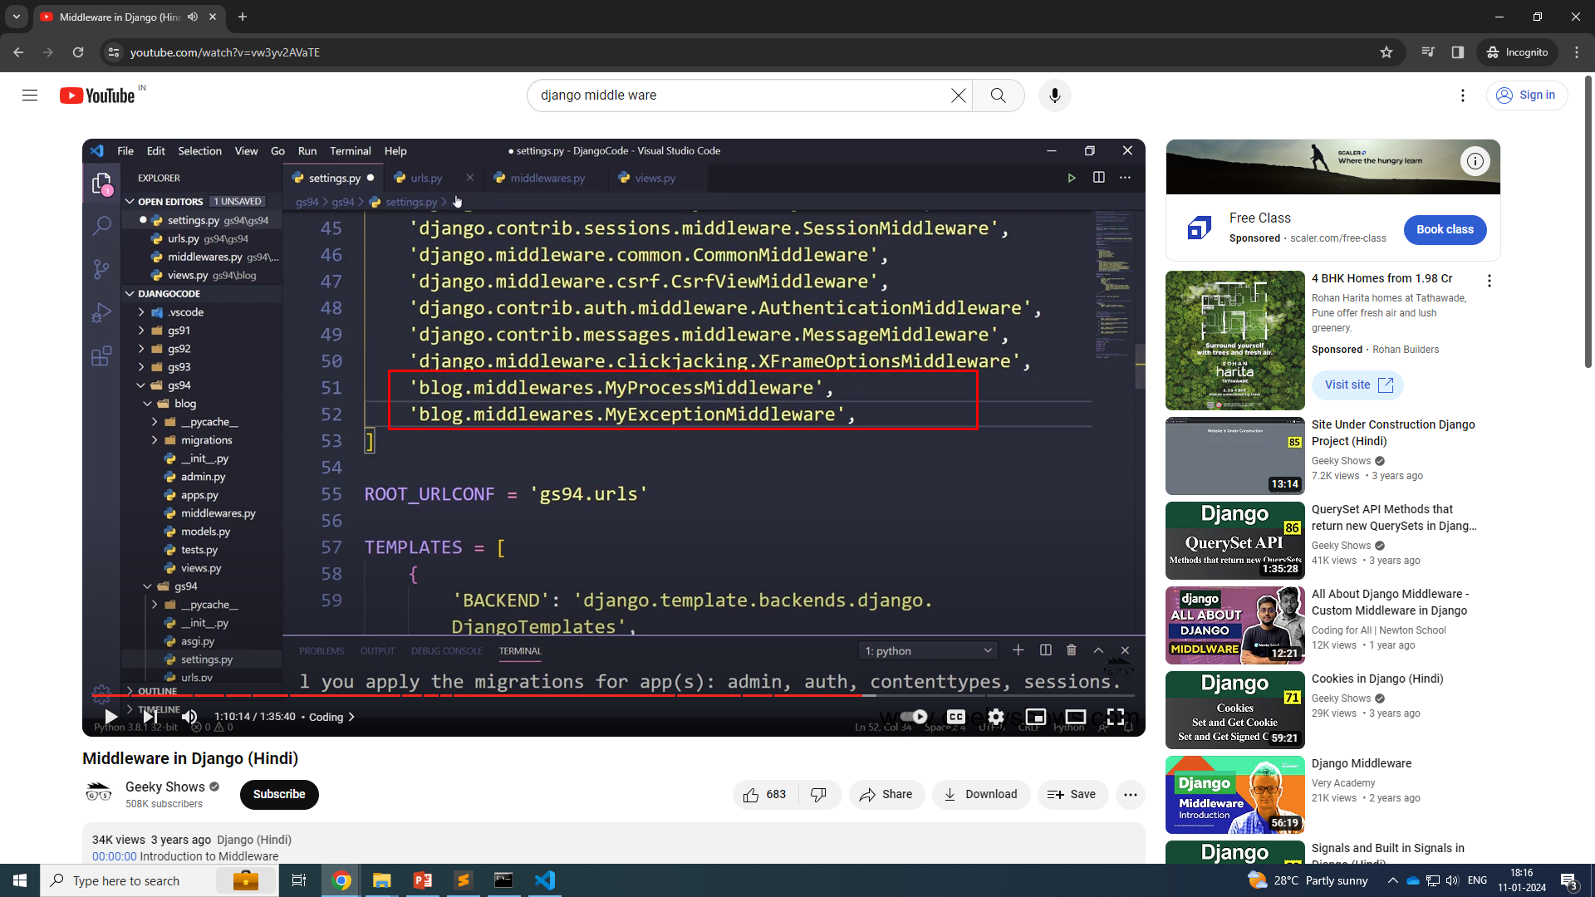

Slide 30
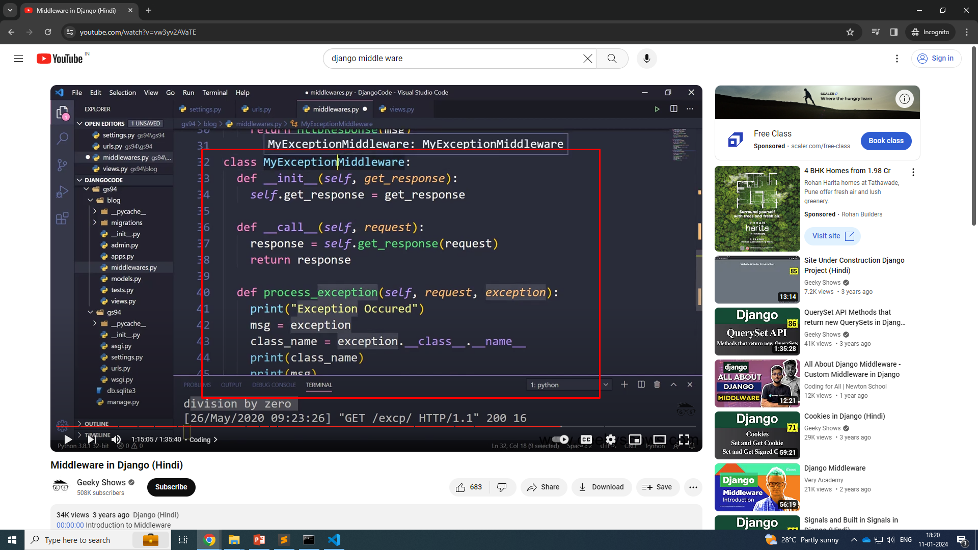

Slide 31
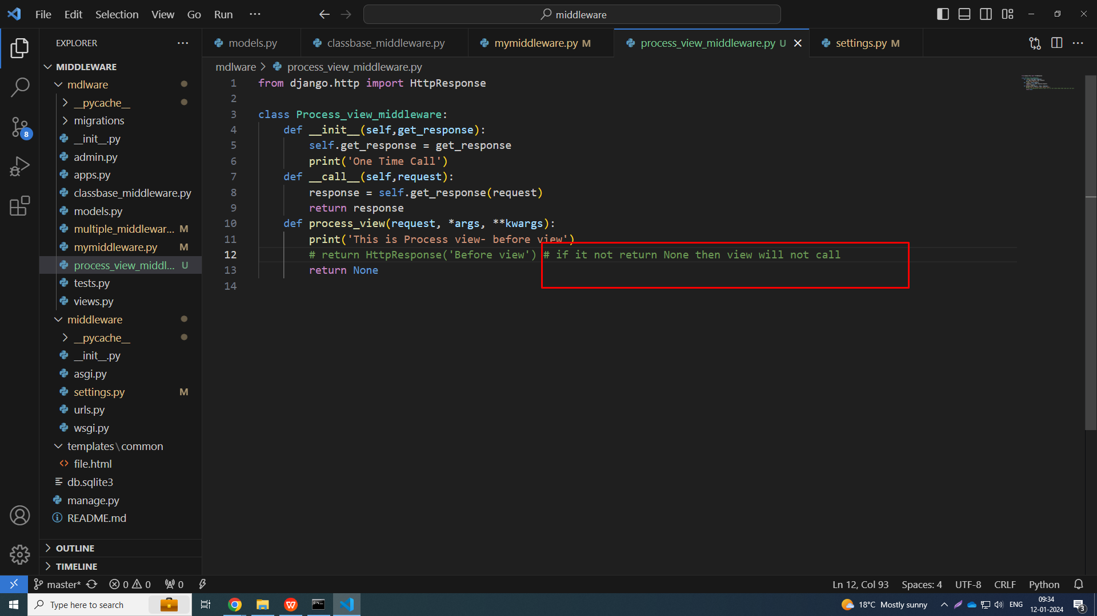

Slide 32
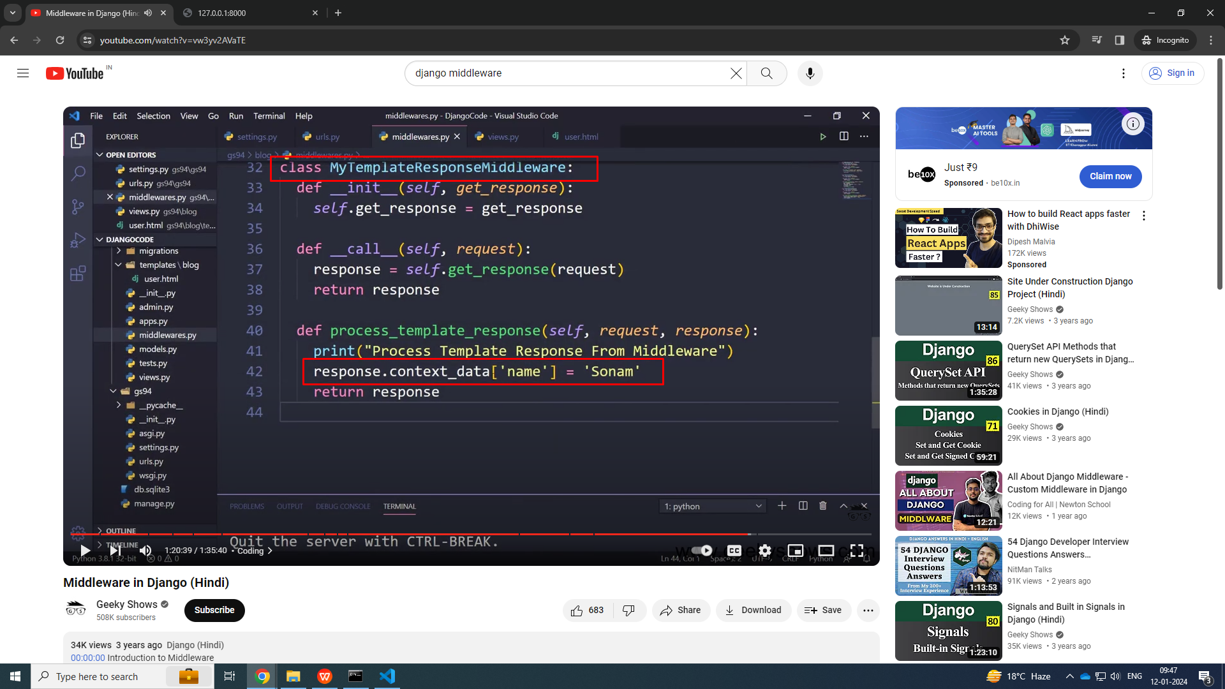
template response view

Slide 33
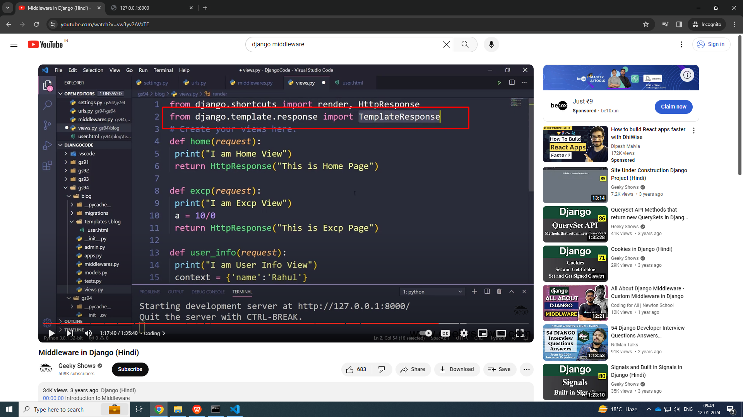

Slide 34
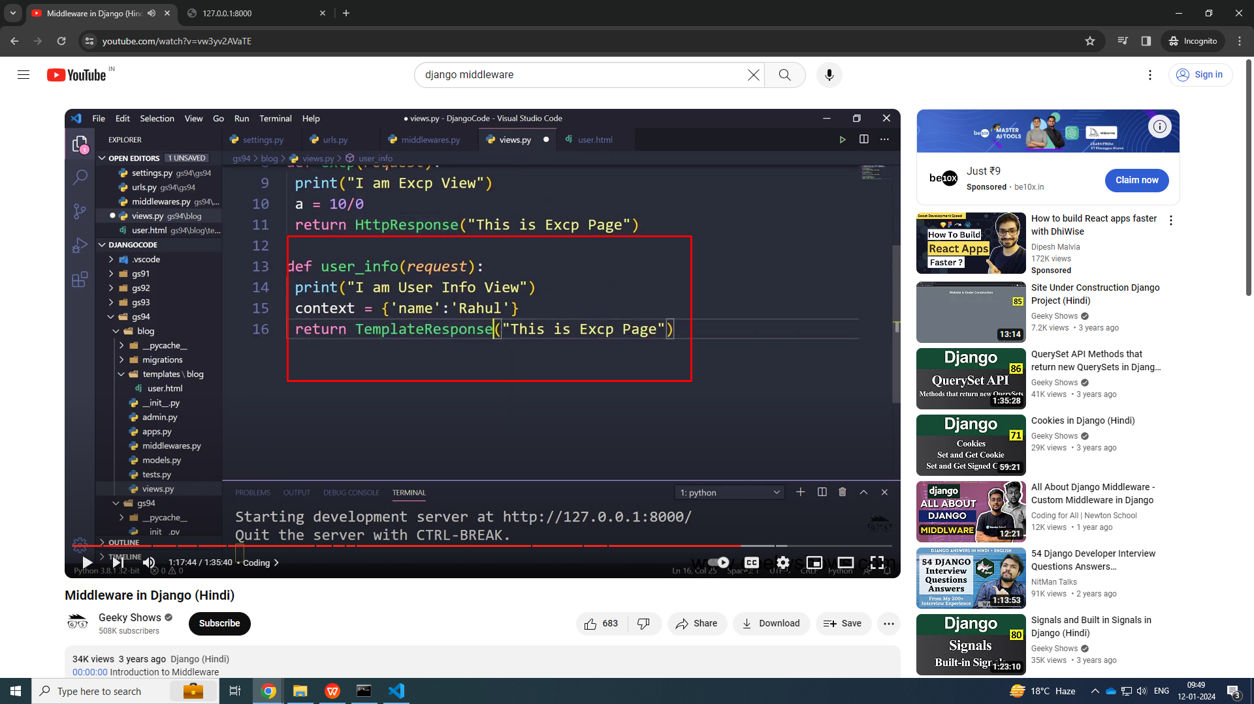

Slide 35
views.py
from django.shortcuts import render, HttpResponse
from django.template.response import TemplateResponse
def Home(request):
# print(10/0)
print('This is the view!!')
context = {
'name': 'test'
}
return TemplateResponse(request, 'common/file.html',context)

Slide 36
from django.http import HttpResponse
class Process_view_middleware:
def __init__(self,get_response):
self.get_response = get_response
print('One Time Call')
def __call__(self,request):
response = self.get_response(request)
return response
# def process_view(request, *args, **kwargs):
# print('This is Process view- before view')
# # return HttpResponse('Before view') # if it not return None then view will not call
# return None
# def process_exception(self,request, exception):
# msg = exception
# classname = exception.__class__.__name__
# data ={
# msg: msg,
# classname : classname
# }
# return HttpResponse(data)
def process_template_response(self, request, response):
print('Process template response view middleware')
response.context_data['name'] = 'Laxman'
return response

Slide 37
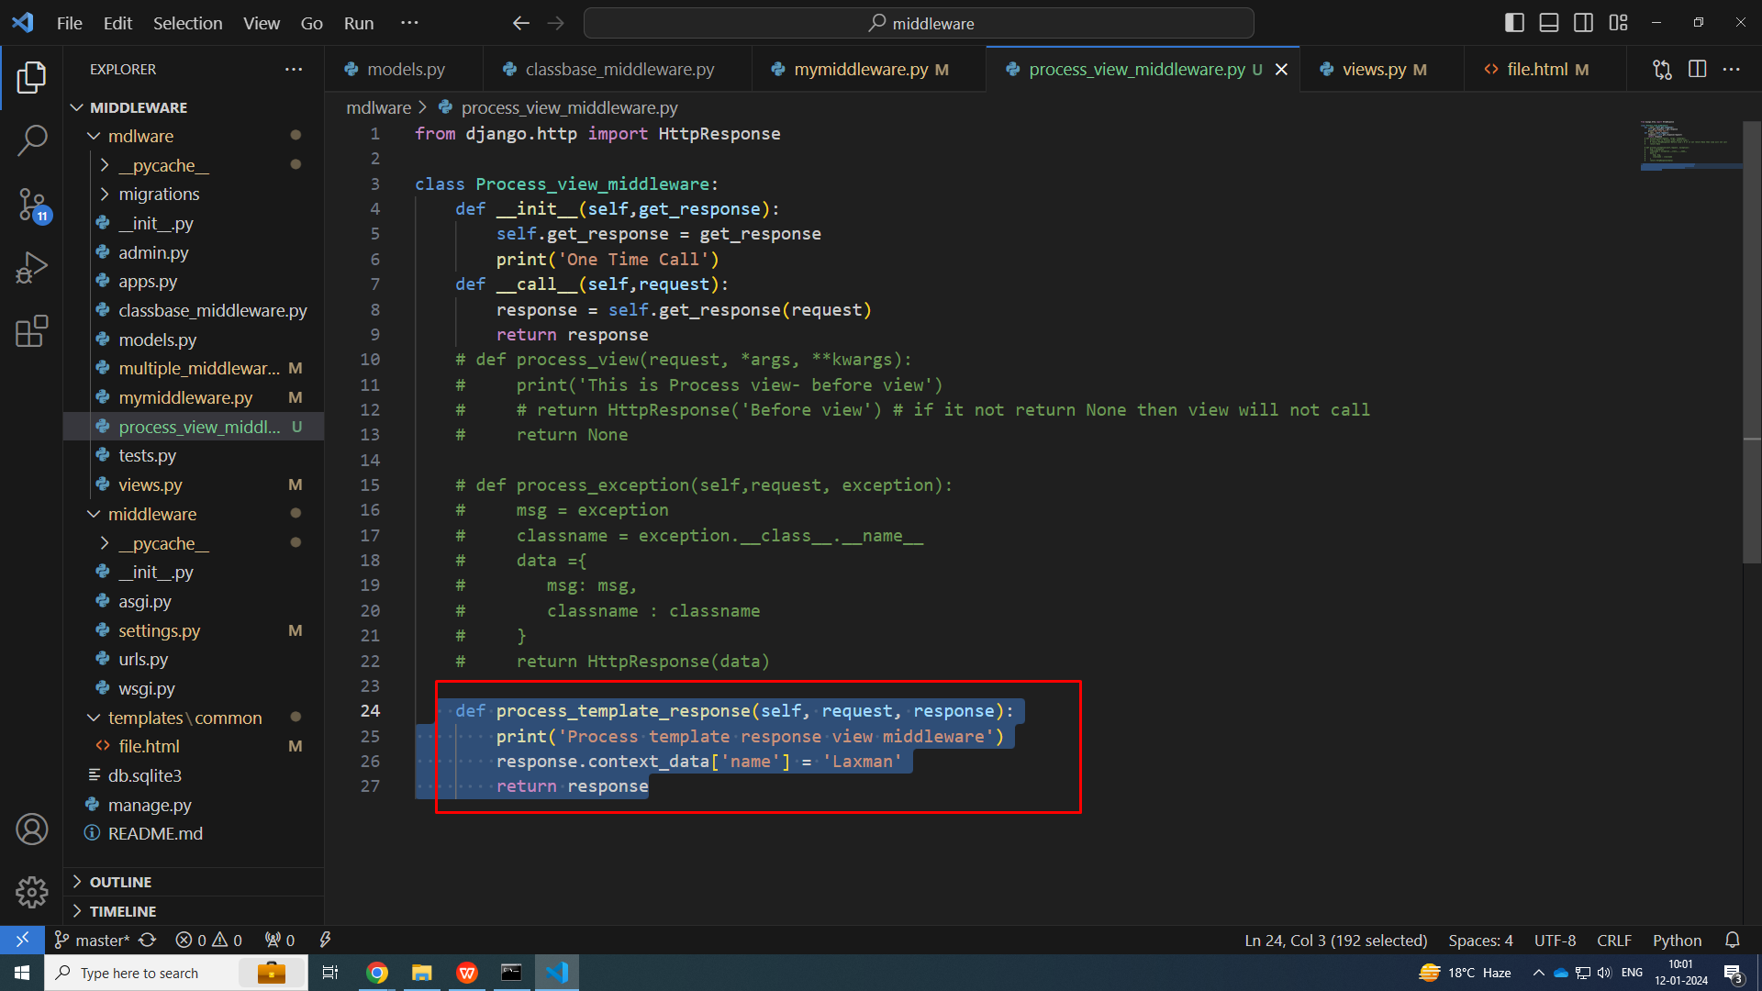

Slide 38
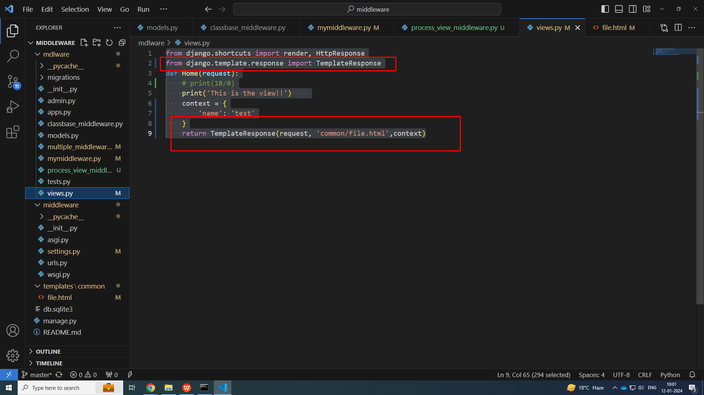

Slide 39
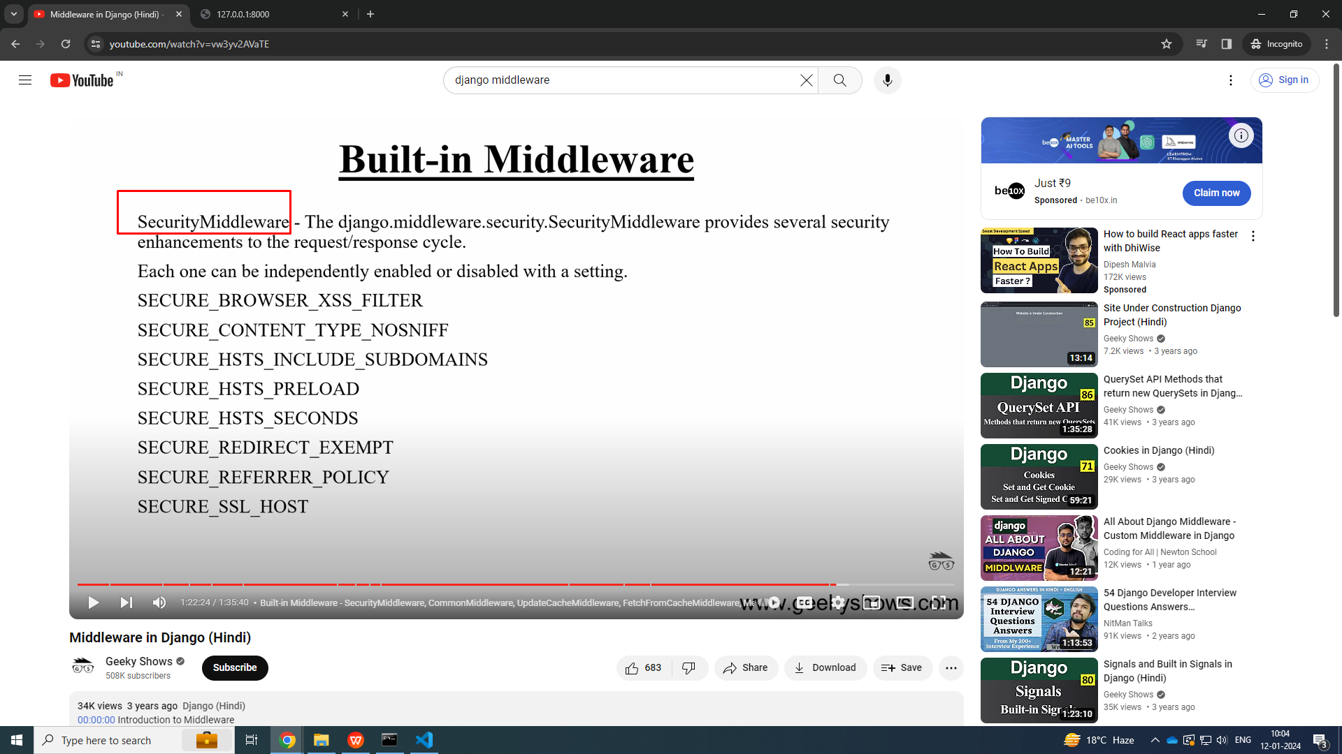
BuILT-IN middleware

Slide 40
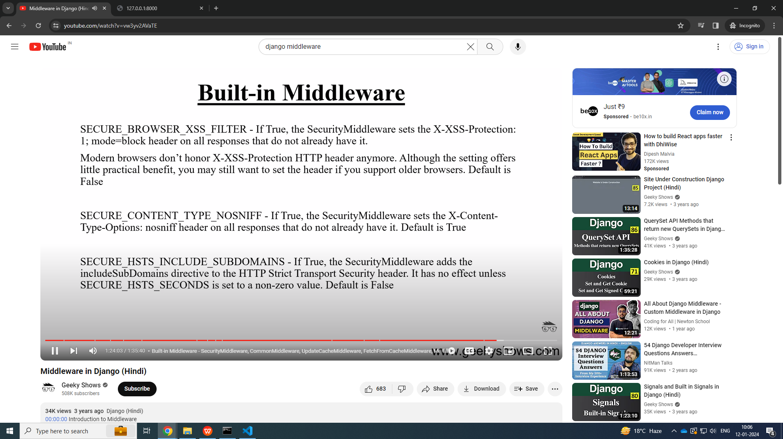

Slide 41
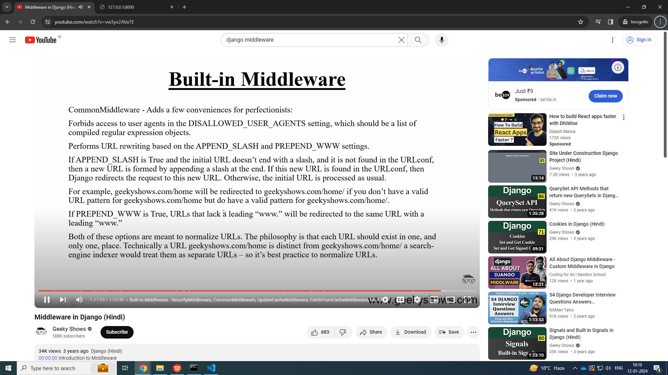

Slide 42
